Slide 1


Presentation on Diwali Sales Analysis
BY :-
Ashish Kumar Gupta

Slide 2

Table of Content :-
Introduction to Data Analytics
Data Analysis and visualization using Python
Python Libraries:
NumPy
Pandas
Matplotlib
Seaborn
Objectives
Project

Slide 3
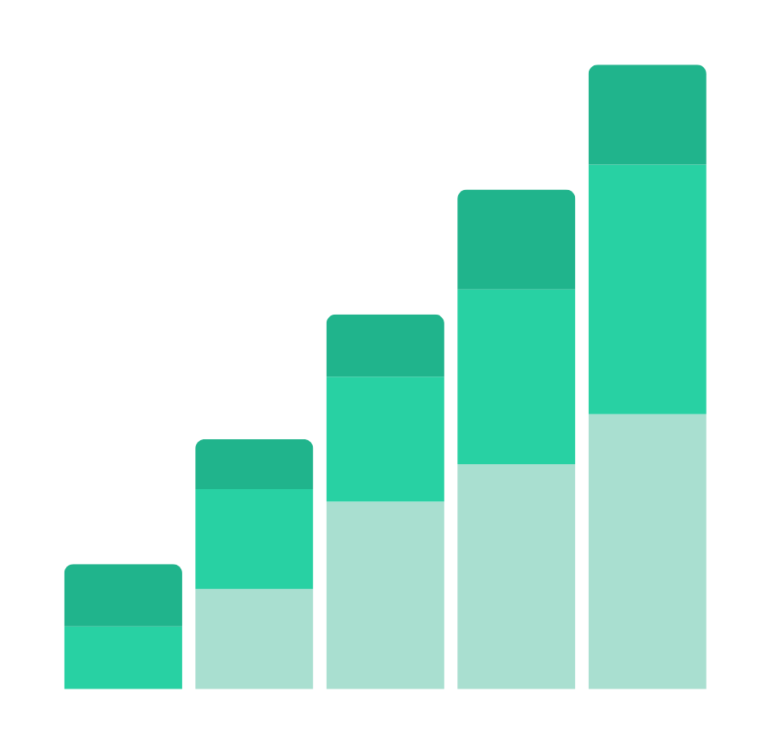
Introduction To Data Analytics
Data analytics is an important field that involves the process of collecting, processing, and interpreting data to uncover insights and help in making decisions. Data analytics is the practice of examining raw data to identify trends, draw conclusions, and extract meaningful information. This involves various techniques and
tools to process and transform data into valuable
insights that can be used for decision-making.

Slide 4
Data Analysis and Visualization using Python
Python is a great language for doing data analysis, primarily because of the fantastic ecosystem of data-centric Python packages. Pandas is one of those packages, and makes importing and analyzing data much easier. In this article, I have used Pandas to analyze data on Country Data.csv file from UN public Data Sets of a popular ‘statweb.stanford.edu’ website. As I have analyzed the Indian Country Data, I have introduced Pandas key concepts as below. Before going through this article, have a rough idea of basics from matplotlib and csv.

Slide 5

Python Libraries :-
NumPy
Pandas
Matplotlib
Seaborn

Slide 6
Libraries Part-1
NumPy
Pandas
Definition: NumPy is a Python library that provides support for large, multi-dimensional arrays and matrices, along with a collection of mathematical functions to operate on these arrays.
Key Features:
Efficient numerical computations.
Core data structure: N-dimensional array (ndarray).
Broadcasting for element-wise operations.
Linear algebra, Fourier transforms, and more.
Use Case: NumPy is the backbone for scientific computing and data manipulation.
Definition: Pandas is a powerful data manipulation library for Python. It provides data structures (such as DataFrames and Series) and tools for cleaning, transforming, and analyzing data.
Key Features:
Tabular data representation (like spreadsheets).
Data cleaning, filtering, and aggregation.
Integration with databases and CSV files.
Time series analysis.
Use Case: Pandas simplifies data wrangling and exploration.

Slide 7
Libraries Part-2
Matplotlib
Seaborn
Definition: Matplotlib is a versatile data visualization library built on NumPy arrays. It allows you to create various types of plots, including line charts, scatter plots, histograms, and more.
Key Features:
Customizable plots and charts.
Supports 2D and 3D visualizations.
Publication-quality graphics.
Use Case: Matplotlib helps you convey insights through visual representations.
Definition: Seaborn is a statistical data visualization library based on Matplotlib. It provides a high-level interface for creating informative and attractive statistical graphics.
Key Features:
Simplified syntax for complex plots.
Built-in color palettes.
Specialized plots (e.g., violin plots, pair plots).
Use Case: Seaborn enhances Matplotlib by adding statistical context to your visualizations.

Slide 8

Project Tasks : Sales Analysis
Perform data cleaning and manipulation
Perform exploratory data analysis (EDA) using pandas, matplotlib and seaborn libraries
Identify insights to improve customer experience by identifying potential customers across different states, occupation, gender and age groups
Identify insights related to most selling product categories and products, which can help to plan inventory and hence meet the demands

Slide 9
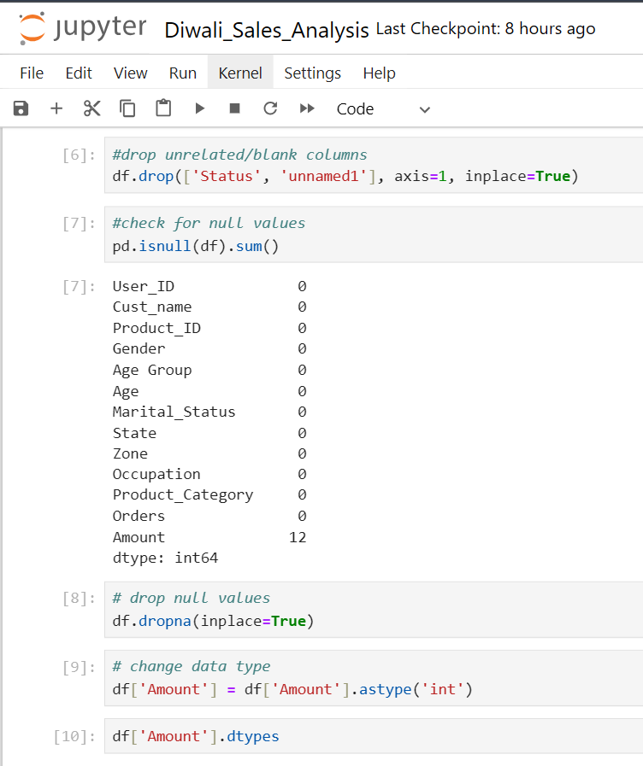
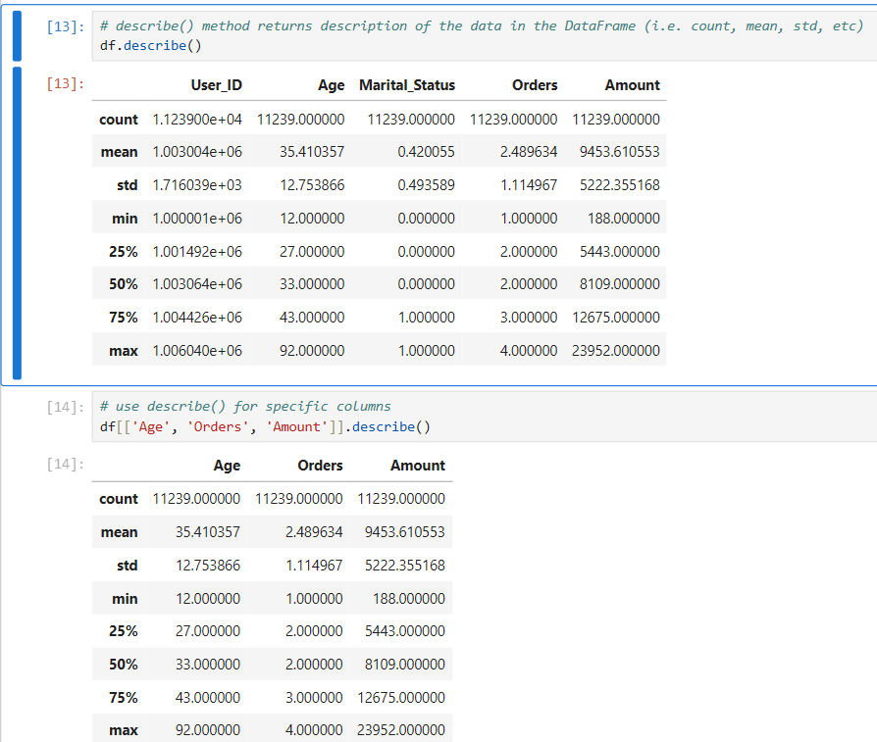
Task 1
Perform data cleaning and manipulation

Slide 10
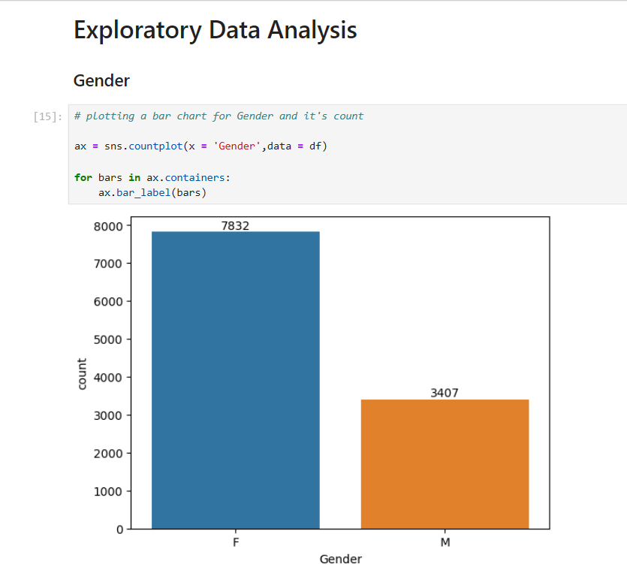
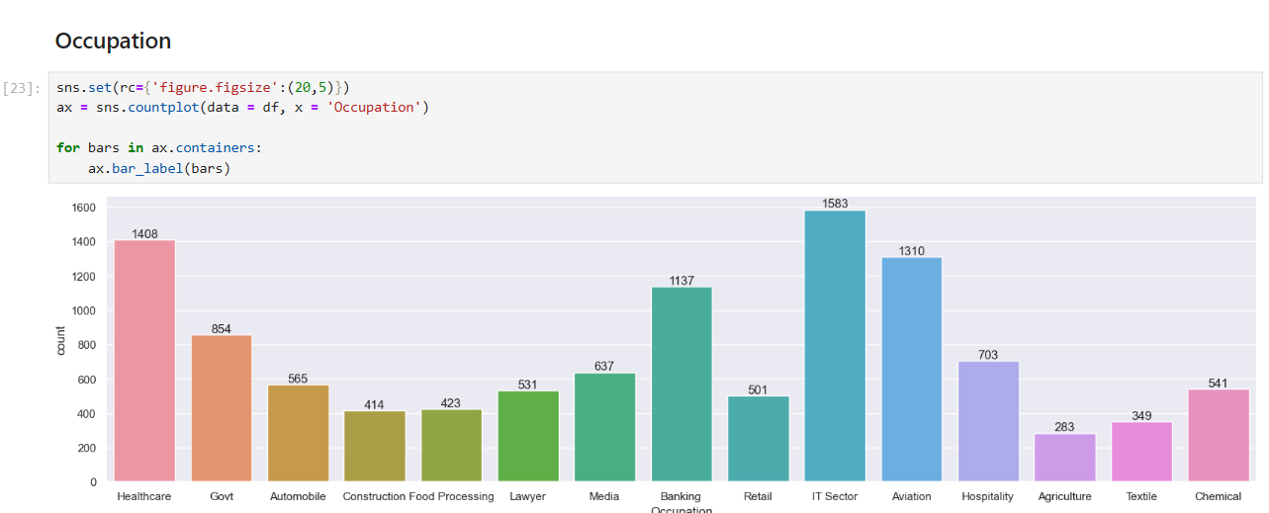
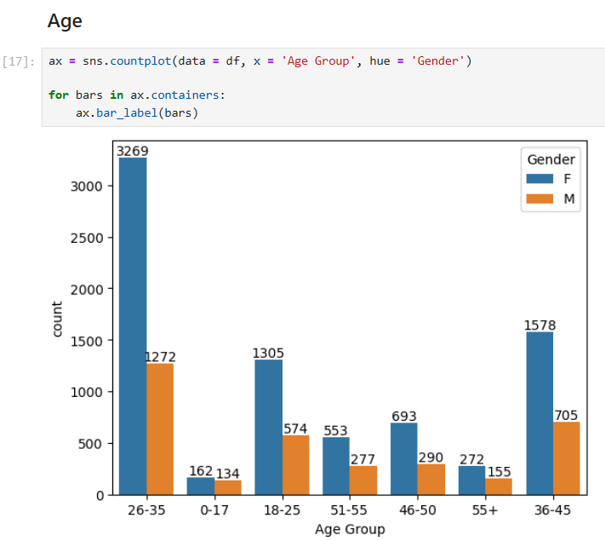
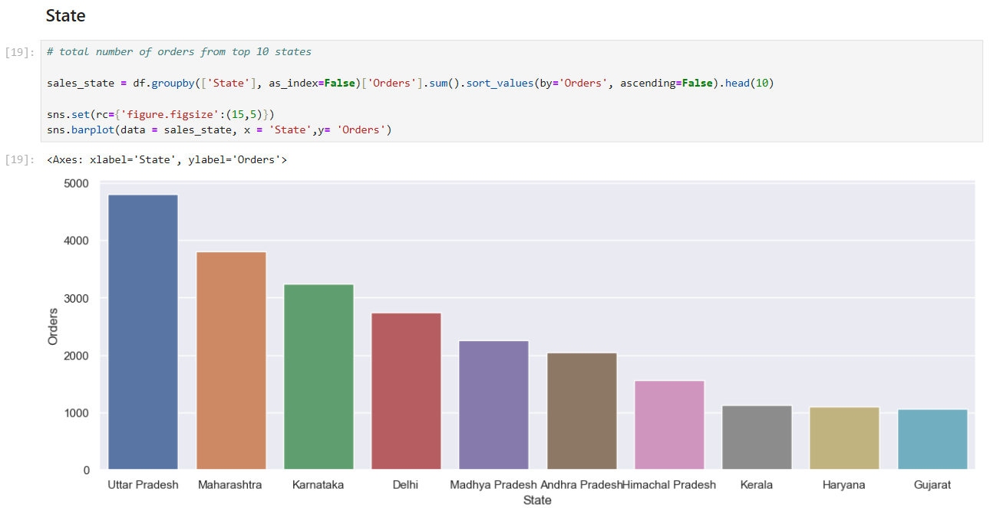
Task 2
Perform exploratory data analysis (EDA) using pandas, matplotlib and seaborn libraries

Slide 11
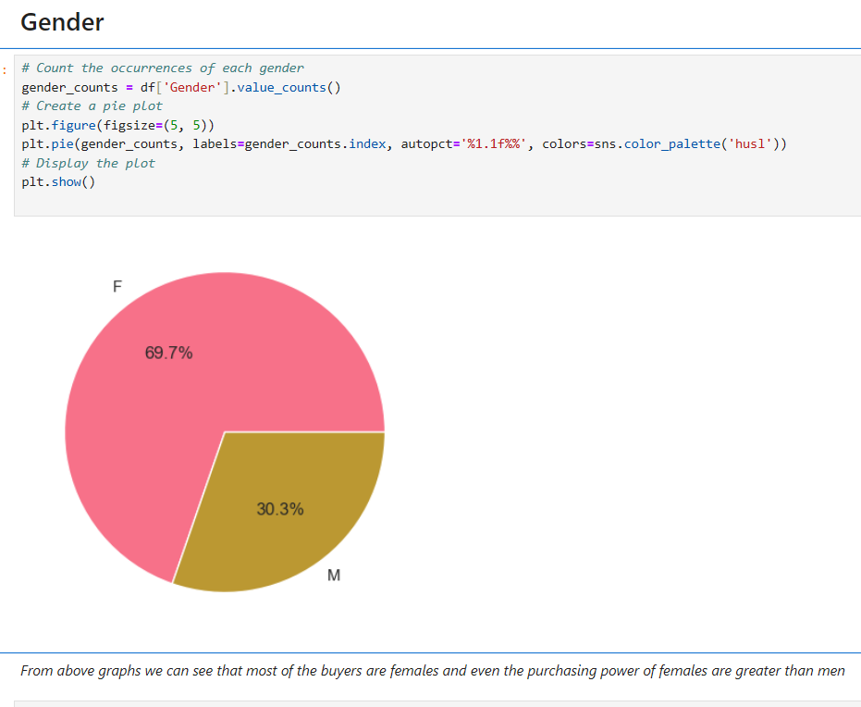
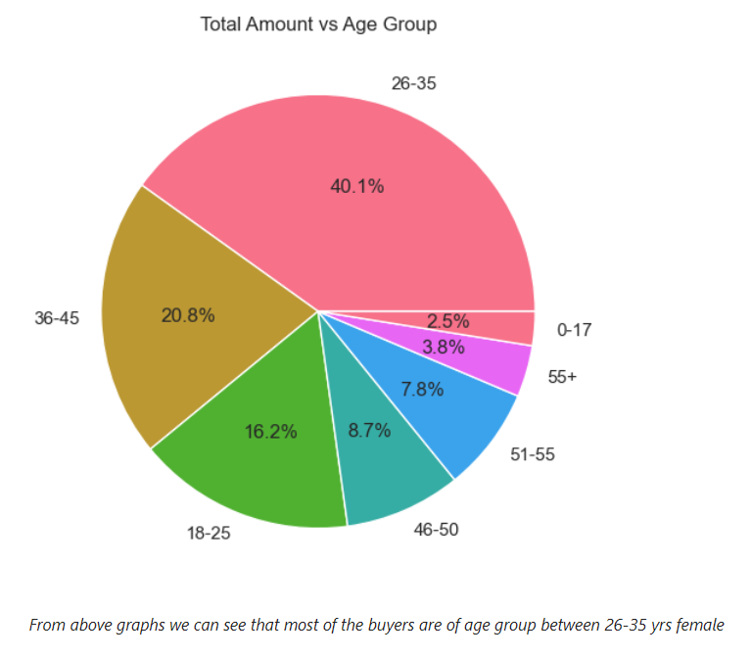
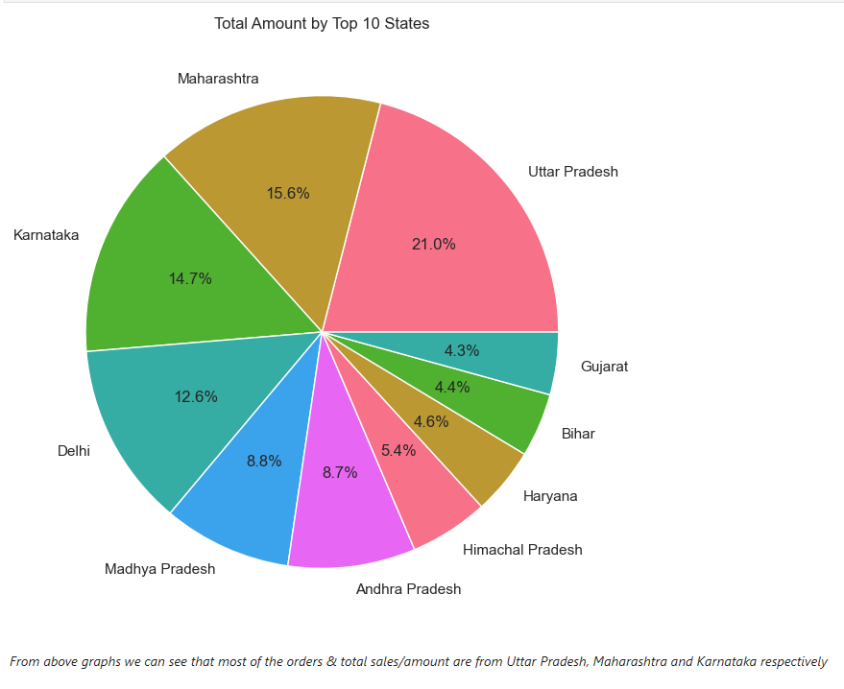
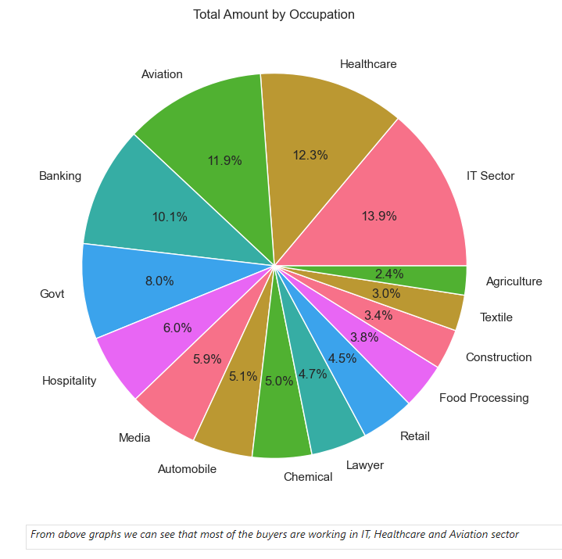
Task 3
Identify insights to improve customer experience by identifying potential customers across different states, occupation, gender and age groups.

Slide 12
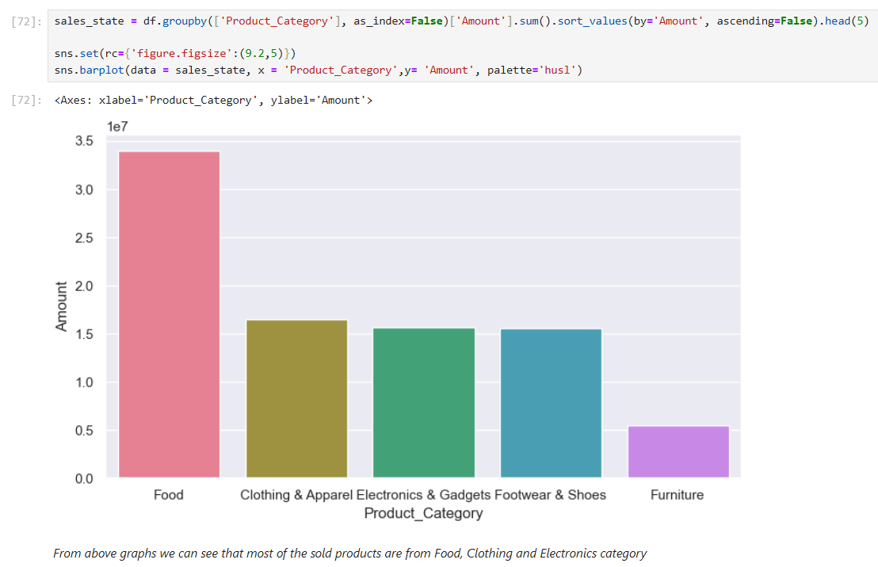
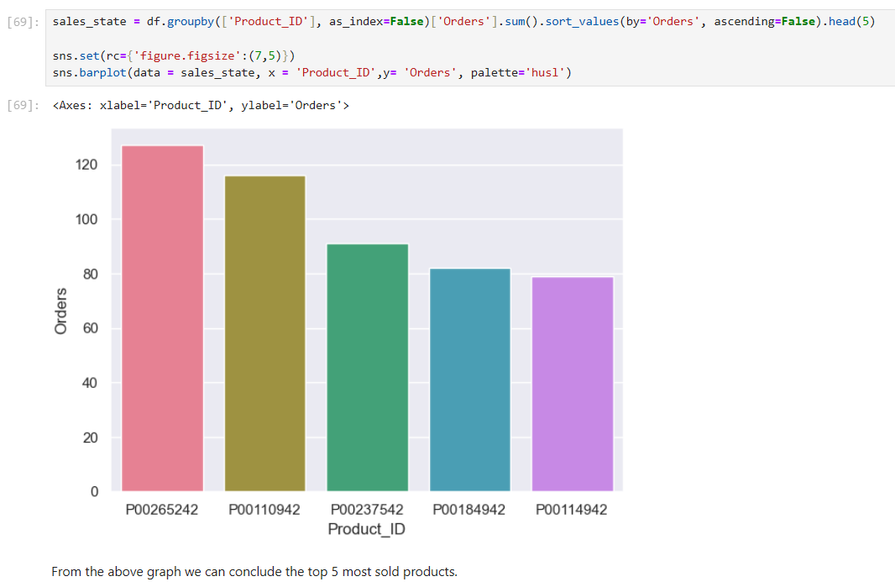
Task 4
Identify insights related to most selling product categories and products, which can help to plan inventory and hence meet the demands

Slide 13

Thank You
☺

